Slide 1
Module-3
Special Theory of Relativity:
Introduction, Inertial frame of reference,
Galilean transformations, Postulates, Lorentz transformations

Slide 2
The Science of Physics is often divided into Classical Physics and Modern Physics. Classical Physics in a model of the macroscopic world around us. All the laws of classical physics were known by the end of the 19th century. Classical physics works well describing and predicting almost all everyday phenomena. The known properties of matter at the end of the 19th century were mass and charge. The smallest constituents were atoms.
The known interactions were gravity, modeled by Newton's law of gravitation, electromagnetic interactions, modeled by Maxwell's equations, and contact force arising from the requirement that "atoms need their space".
Consequences of the interactions were described by Newton's laws of motion, which predict how matter behaves when acted on by forces. Statistical physics and thermodynamics were developed for describing systems with a large number of degrees of freedom.

Slide 3
Modern Physics is the physics of the 20th century. The main building blocks, the theory of relativity and quantum mechanics, were developed early in that century.
THE TWO PROBLEMS WITH CLASSICAL PHYSICS THAT BECAME APPARENT AT THE END OF
THE 19TH CENTURY WERE:-
The ultraviolet catastrophe: According to classical physics, the energy emitted by a blackbody should increase indefinitely as the frequency of the radiation increases.
This means that at high frequencies, the radiation should have infinite energy, which is obviously not observed. This was known as the "ultraviolet catastrophe" because it predicted an infinite amount of energy in the ultraviolet range of the electromagnetic spectrum.
2.The photoelectric effect: Another problem with classical physics was that it could not explain the photoelectric effect, which is the observation that electrons are emitted from a metal surface when it is exposed to light of a certain frequency. According to classical physics, the energy of the electrons emitted should increase as the intensity of the light increases, but this is not what is observed. Instead, the energy of the electrons depends only on the frequency of the light, which is not predicted by classical physics.
These problems led to the development of quantum mechanics, which is a new framework for describing the behavior of matter and energy on a microscopic scale.

Slide 4
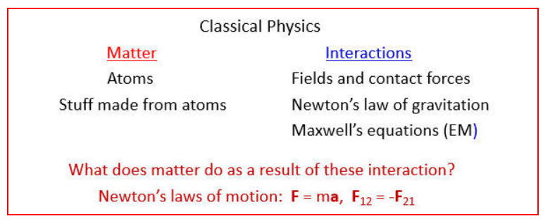
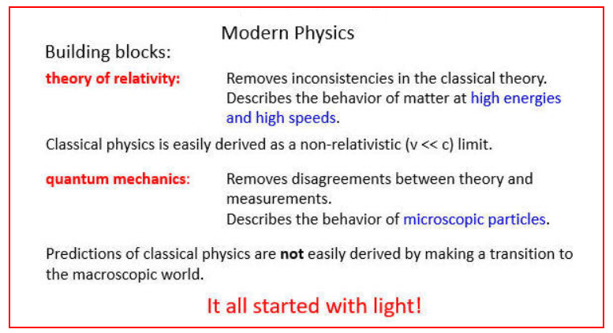

Slide 5
Einstein special theory of relativity resolves the conflict between Newton's laws of motion and Maxwell's equations.
Einstein proposed two postulates.
The laws of nature are the same in all inertial reference frames.
II. In vacuum, light propagates with respect to any inertial frame and in all directions with the universal speed c. This speed is a constant of nature.

Slide 6
Introduction:
The theory of relativity was successfully described by Einstein in 1905.
It was related to the relative motion of the objects or we can say it deals with the motion of object or observer moving with relative velocities w.r.t. each other.
This theory has two parts:-
Special Theory of Relativity
(What is Spatial in it:- Object is moving constant velocity and the velocity of object will be comparable to the velocity of Light)
Special theory of relativity was formulated by A. Einstein in 1905. In this theory we deal with the relative motion of the objects, which are moving with constant velocity or are at rest w.r.t. one another. The main aim of this theory was to solve the problem of absolute motion of bodies.
2. General Theory of Relativity
But Einstein found that there is no absolute motion in free space.
In general theory of relativity (1915) we deal with the problem that involves frame of reference accelerated w.r.t. one another.

Slide 7
There are two types of frames of reference:-
1. Inertial frame of reference
2. Non – inertial frame of reference
S. No. | Inertial Frame of Reference | Non – inertial Frame of Reference
1. | If in a given system a free object does not experience any acceleration or a force, the system is called the inertial frame. Any reference of frame that moves with the constant velocity relative to an inertial frame of reference is itself an inertial frame. | If we consider a free object in an accelerated frame, the object experiences acceleration or a force applied on it. Such a frame of reference is called non – inertial frame.
2. | Newton’s laws are found to be valid in these frames of references. | Newton’s laws are not valid.
3. | Example: - A passenger in a car, moving with uniform velocity experiences no force on him. | Example: - A passenger in a car which is accelerating, experiences a push backward though no external force is applied on him.

Slide 8
Special Theory of Relativity:
The two basic postulates on which the theory rests may be stated in a precise form thus:
The laws of physics all take the same identical form for all frames of reference in uniform relative motion, i.e., for all inertial frame of reference.
This postulate follows from the absence of universal frame of reference. If the laws of physics were different for different observers in relative motion, the observers could find from these differences which of them were “stationary” in space and which were “moving”. But such a distinction does not exist, and the principle of relativity expresses this fact.
This postulate is, also called as principle of equivalence.
The speed of light is constant in vacuum for all observers, i.e., speed of light is a universal constant. The speed of light in vacuum neither depends on the direction of light nor the motion of the source and the observer. In other words, the speed of light in vacuum has the same value in all directions in all inertial frames of reference.

Slide 9
Lorentz Transformations :
S Y S’ Y’
v
P (x, y, z,t)
(x’, y’, z’, t’)
Consider two inertial frames of references S and S’. The frame S’ is moving with uniform velocity v w.r.t. S along +X direction such that Y and Z axes of both frames remains parallel to each other as shown in fig.5
O
O’
X X’
At any time t
Fig.5
Let t and t’ are the times of an event measured by the observer sitting at the origin O and O’ of both frames respectively. For convenience let us assume that at t = t’ = 0 the origins O and O’ of frames S & S’ are coincident.
Let a pulse of light is generated at time t = 0 at the origin which grows in the space. Now
consider the situation when the pulse reaches at pt. P. Let (x, y, z, t) and (x’, y’, z’, t’) be the
positions and time coordinates of P measured by observers O and O’ in frames S and S’
respectively. When the pulse is observed from S, then we have
Velocity of light = distance /time

Slide 10
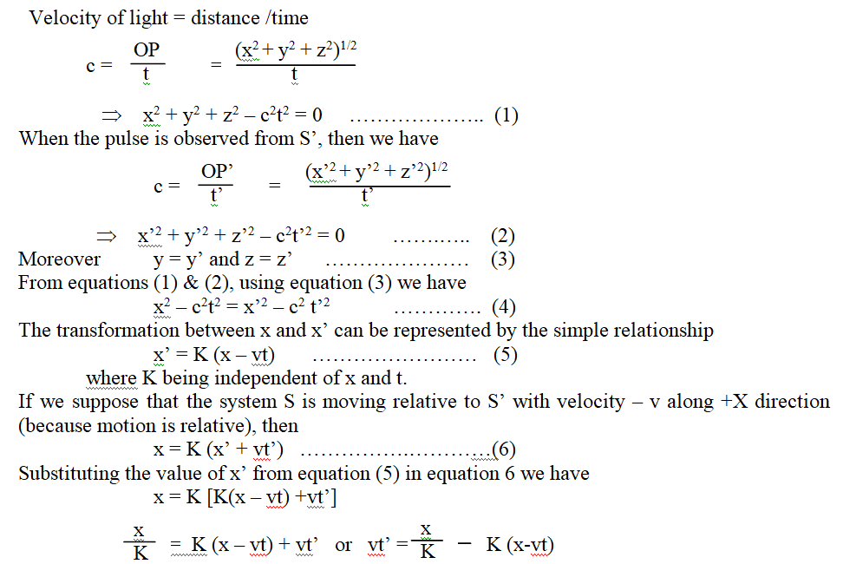
S Y S’ Y’
v
P (x, y, z,t)
(x’, y’, z’, t’)
O
O’
X X’
At any time t
Fig.5

Slide 11

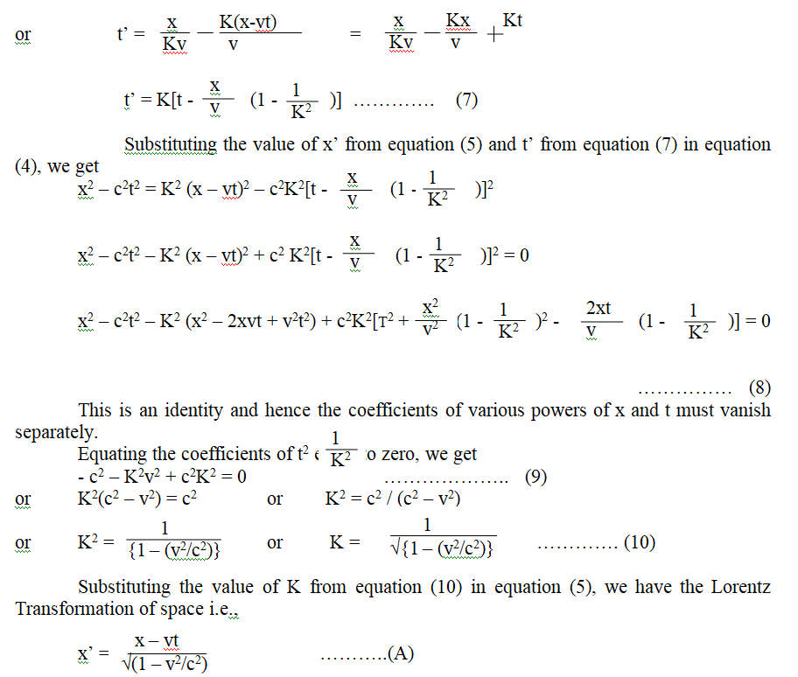

Slide 12
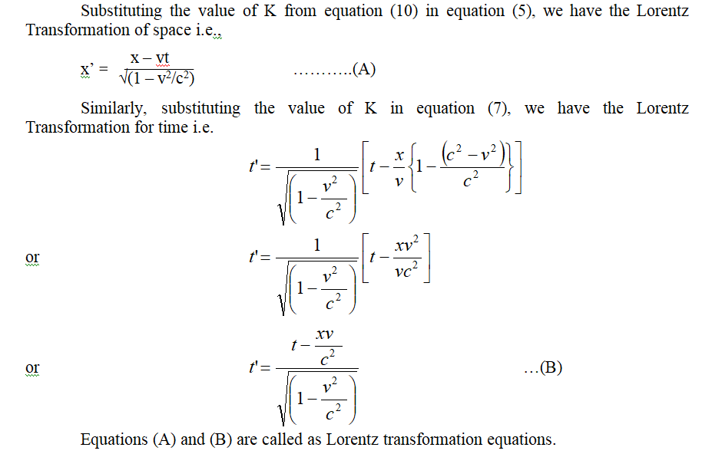



Slide 13
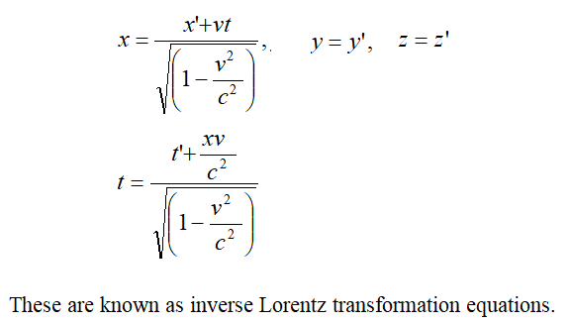
Inverse Lorentz transformation equation

Slide 14
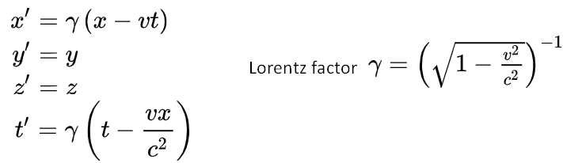
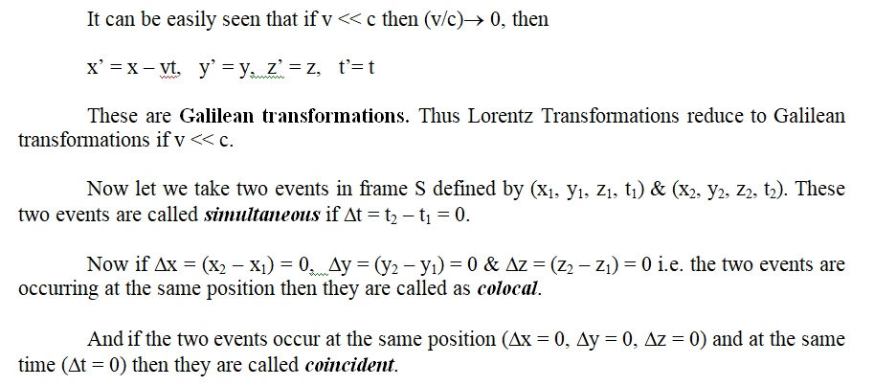
Special cases of L.T. equitation's

Slide 15
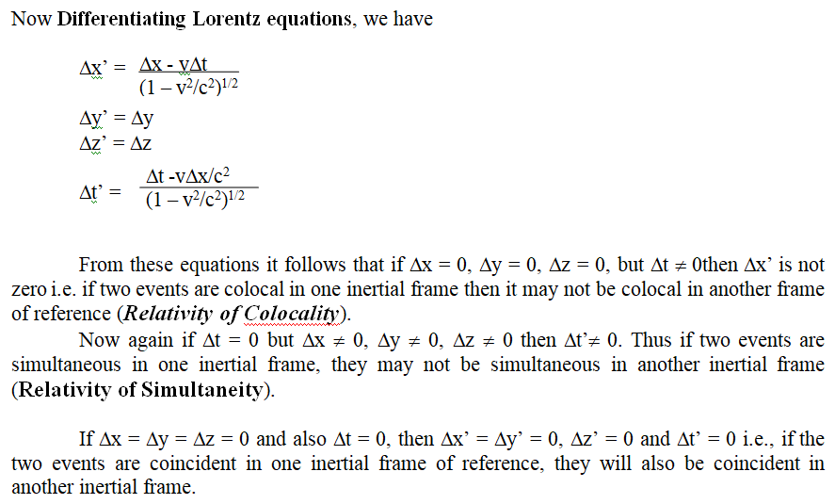

Slide 16
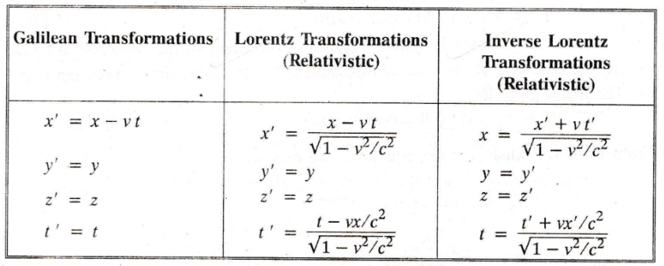

Slide 17
Conclusions of Lorentz transformations
The Lorentz transformations are a set of equations that relate the space and time coordinates of events in different inertial frames of reference that move at a constant speed relative to each other. They are consistent with the postulates of special relativity, which state that the laws of physics are the same in all inertial frames and that the speed of light is constant in vacuum.
Some of the conclusions of the Lorentz transformations are:
Length contraction: The length of an object moving along its direction of motion is shorter than its length at rest, as measured by an observer in a different frame. The factor by which the length contracts is called the Lorentz factor, given by γ = 1 √1 − v²c² , where v is the relative speed of the frames and c is the speed of light.
Time dilation: The time interval between two events occurring at the same location in a moving frame is longer than the time interval measured by an observer in a stationary frame. The factor by which the time dilates is also given by the Lorentz factor.
Relativity of simultaneity: Two events that are simultaneous in one frame of reference may not be simultaneous in another frame. The difference in time between the events depends on the relative speed and distance between the frames.
Velocity addition: The velocity of an object measured in one frame of reference is not simply added to or subtracted from the relative velocity of another frame. Instead, a more complicated formula involving the Lorentz factor and the speed of light is used to find the velocity of the object in another frame.
Mass-energy equivalence: The mass of an object increases with its speed, as measured by an observer in a different frame. The increase in mass is related to the increase in kinetic energy by the famous equation E = mc2 , where E is the energy, m is the mass, and c is the speed of light.
These conclusions have profound implications for our understanding of space and time, and challenge our common sense notions based on classical mechanics.

